Slide 1
Recent Thoughts on AI

Slide 2
Who Am I

Slide 3
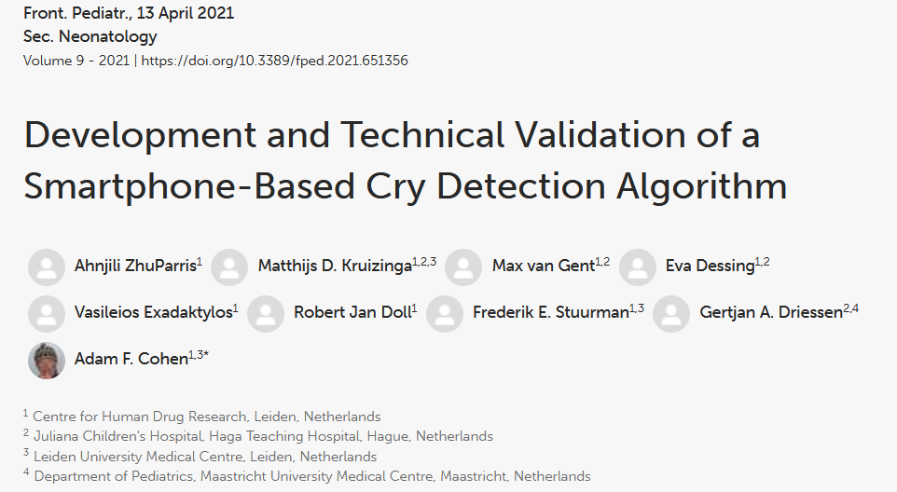
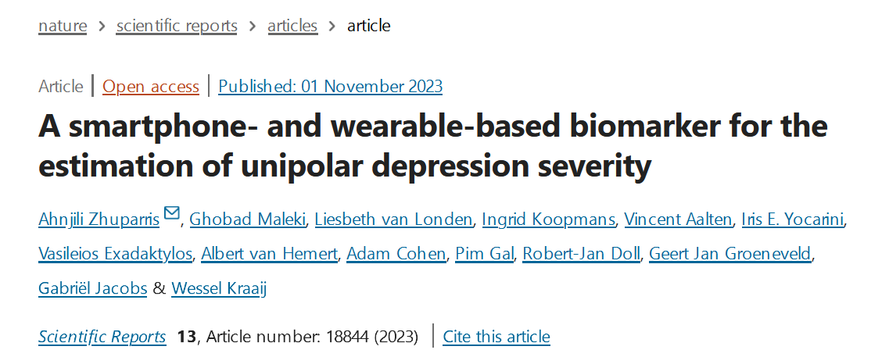
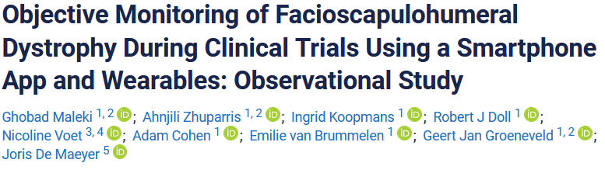
Ahnjili ZhuParris PhD
Ex-Academic focusing on Medical Surveillance

Slide 4
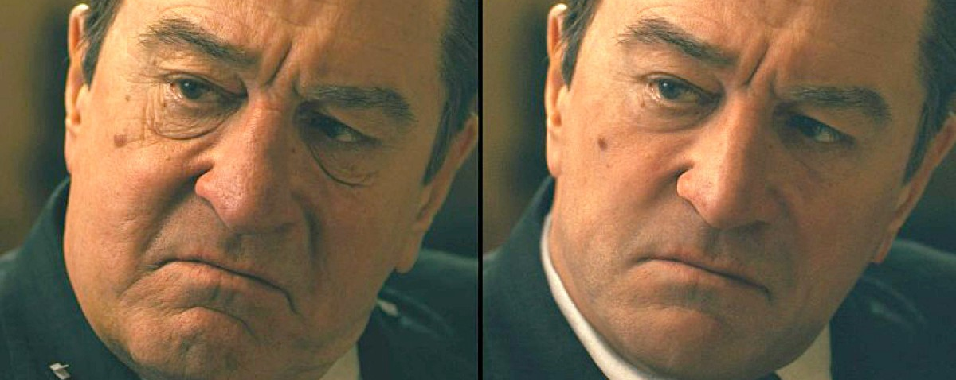
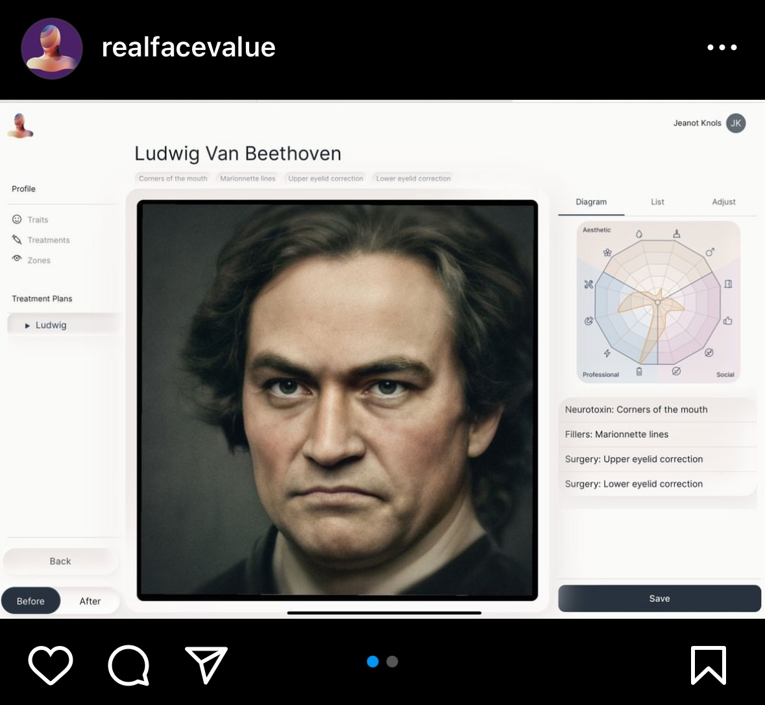
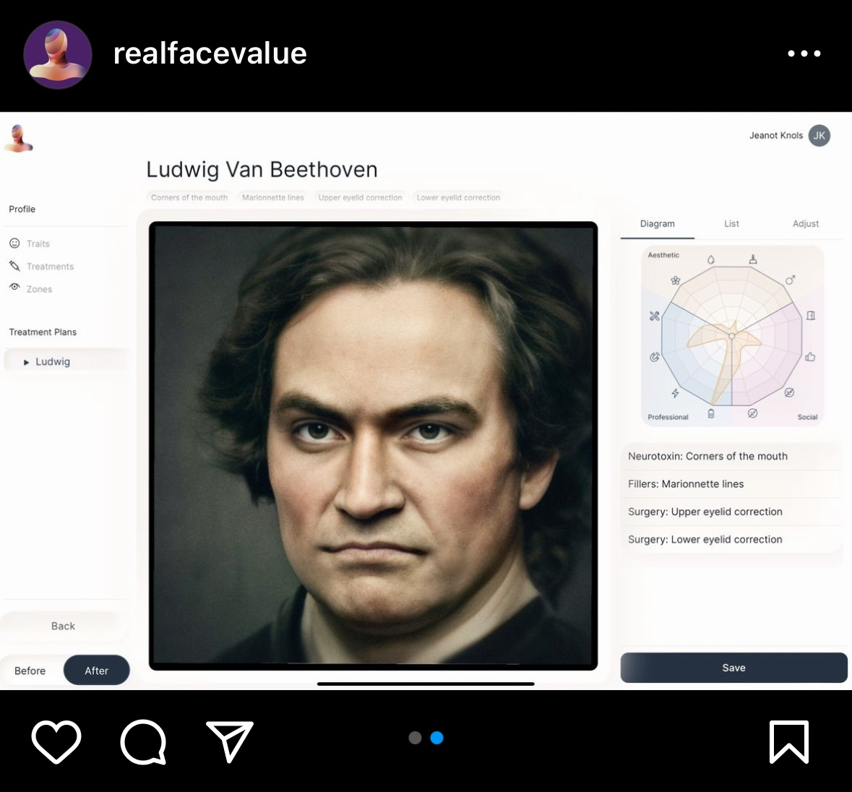
Ahnjili ZhuParris PhD
AI Engineer (Computer Vision)

Slide 5
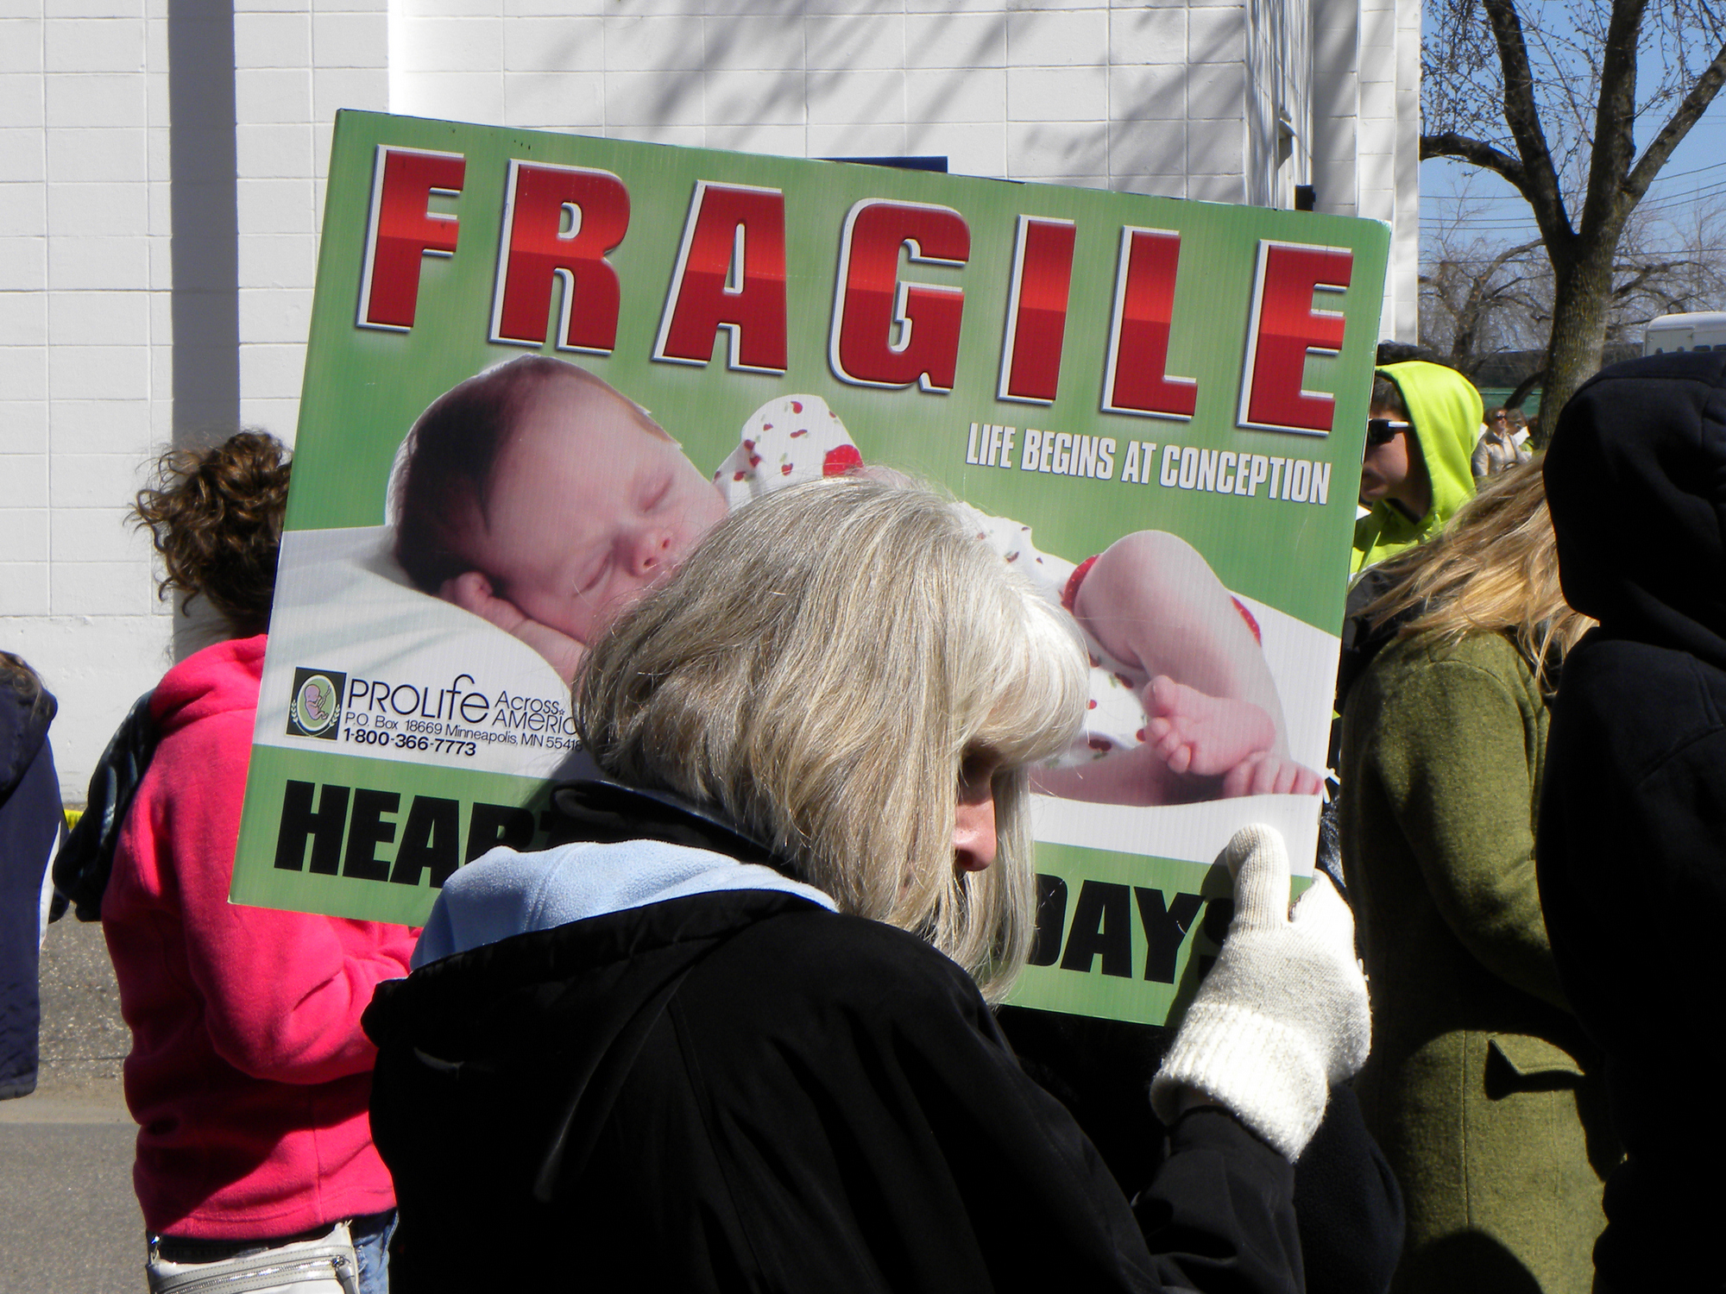
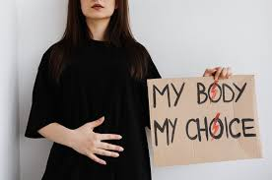
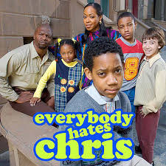

Ahnjili ZhuParris PhD
AI Engineer (Media Researcher)

Slide 6
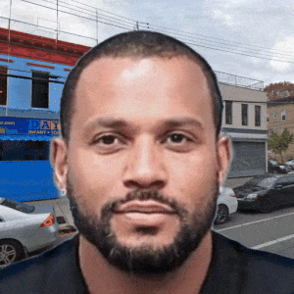
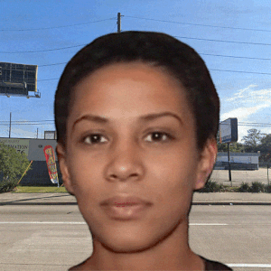
Ahnjili ZhuParris PhD
Computational Artist

Slide 7
Goals as an Artist

Slide 8
My Thematic Motivations
To Inform The Public
To Question the Applications & Ethics
To Explore Alternative Futures

Slide 9
To Inform The Public

Slide 10
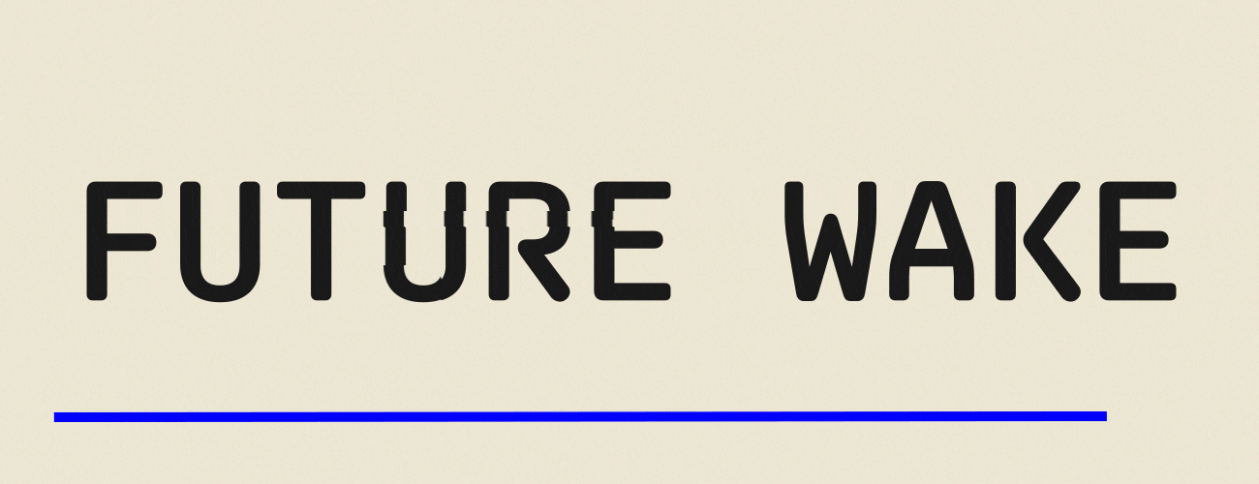
www.futurewake.com
Use predictive policing methods to predict when the police would commit a crime

Slide 11
Future Wake
The Data
The Algorithm
Notes:
No federal database, citizen database
Crazy bad

Slide 12
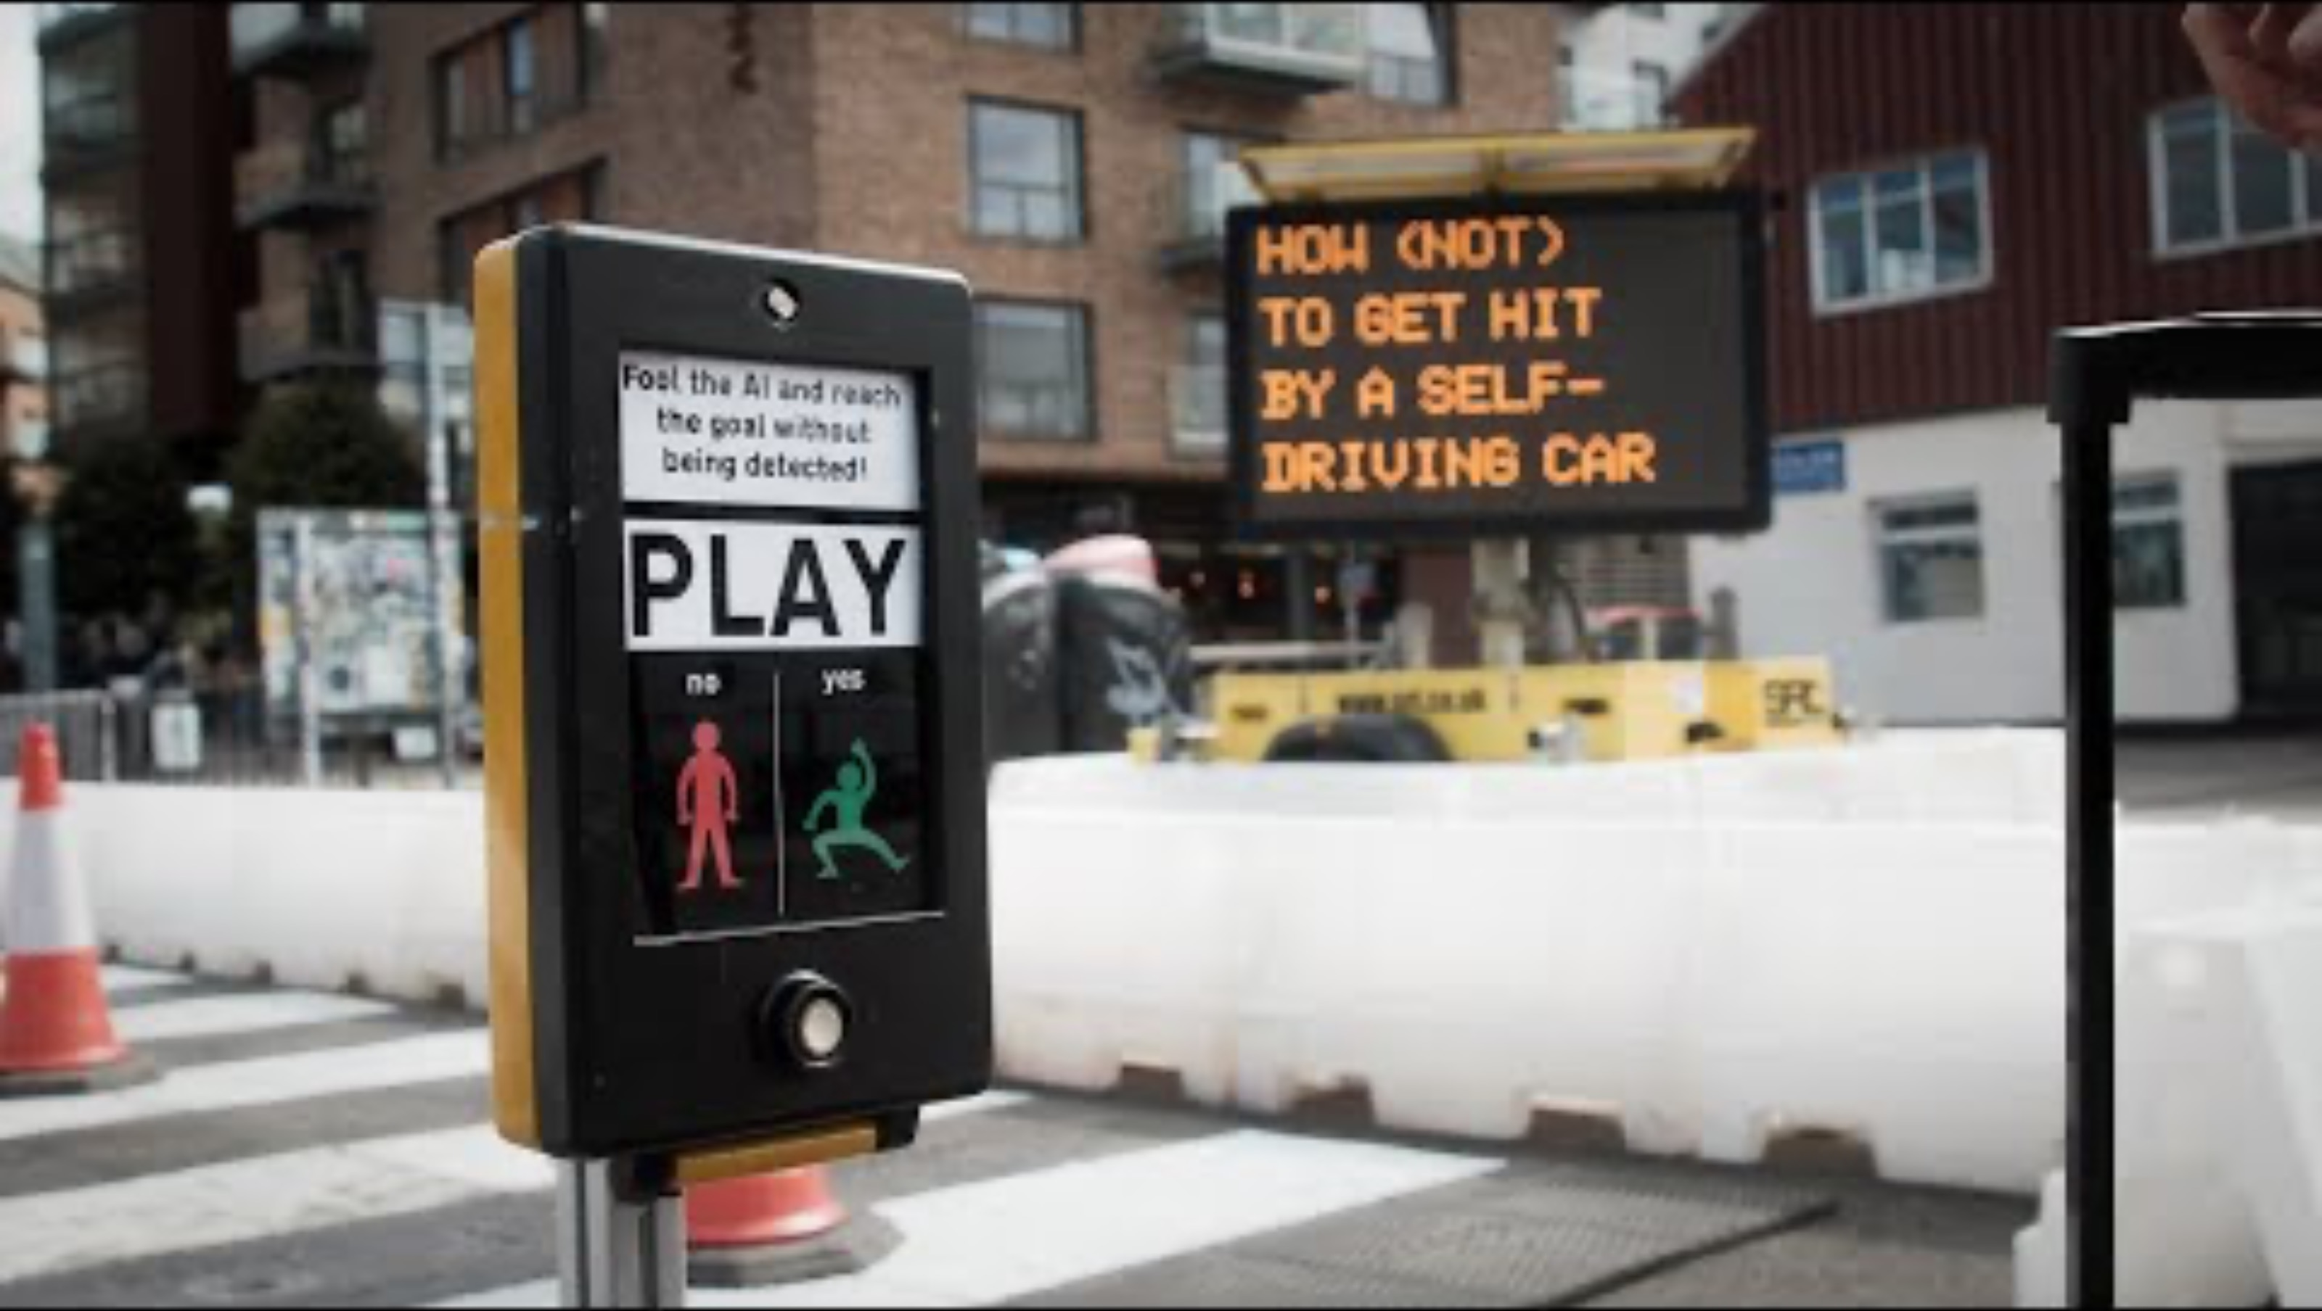
Tomo Kihara

Slide 13
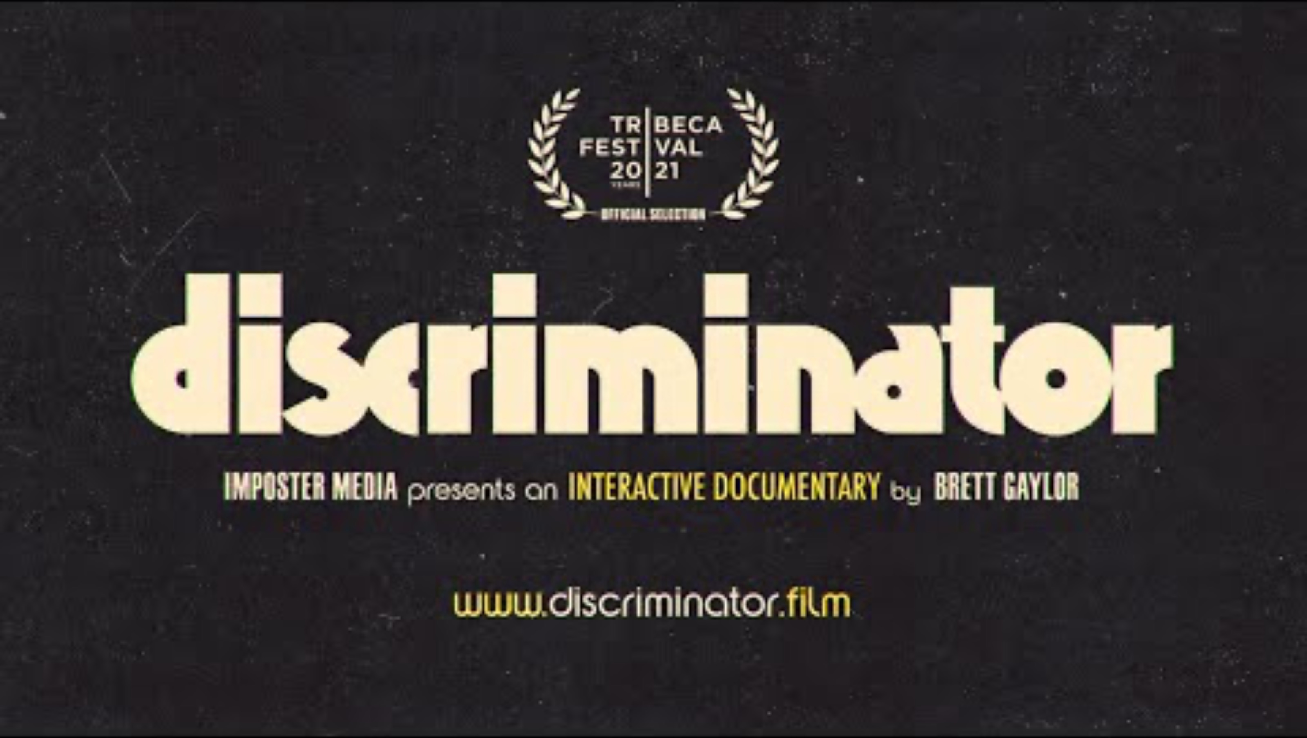
Brett Gaylor – Discriminator

Slide 14
To Questions the Applications & Ethics

Slide 15
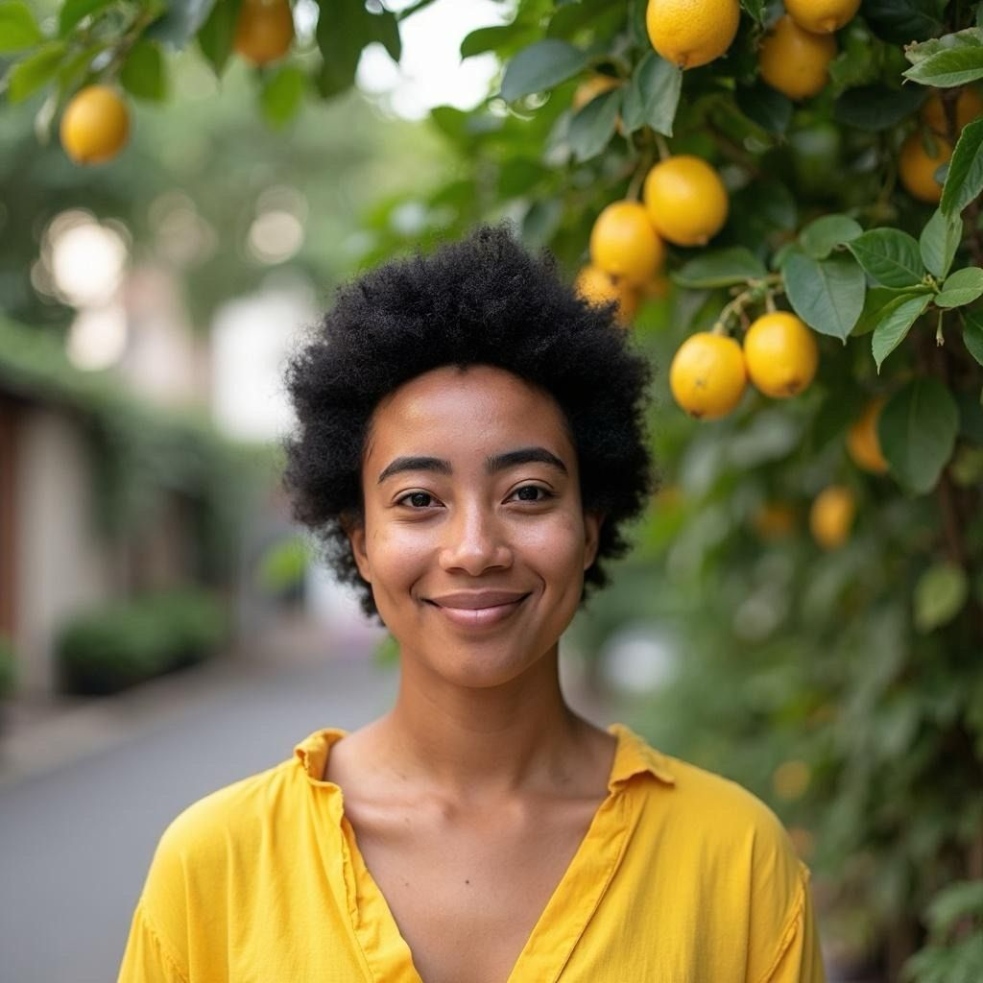
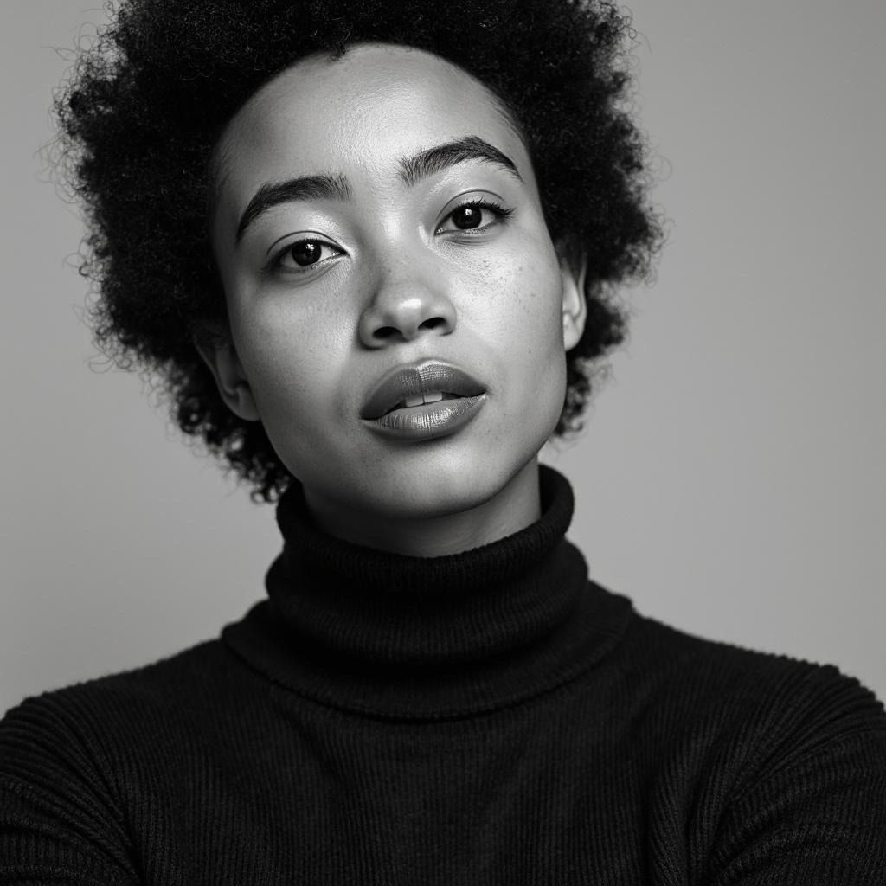



DEEPFAKE – A Video Essay
* All of the media content here are deepfakes

Slide 16
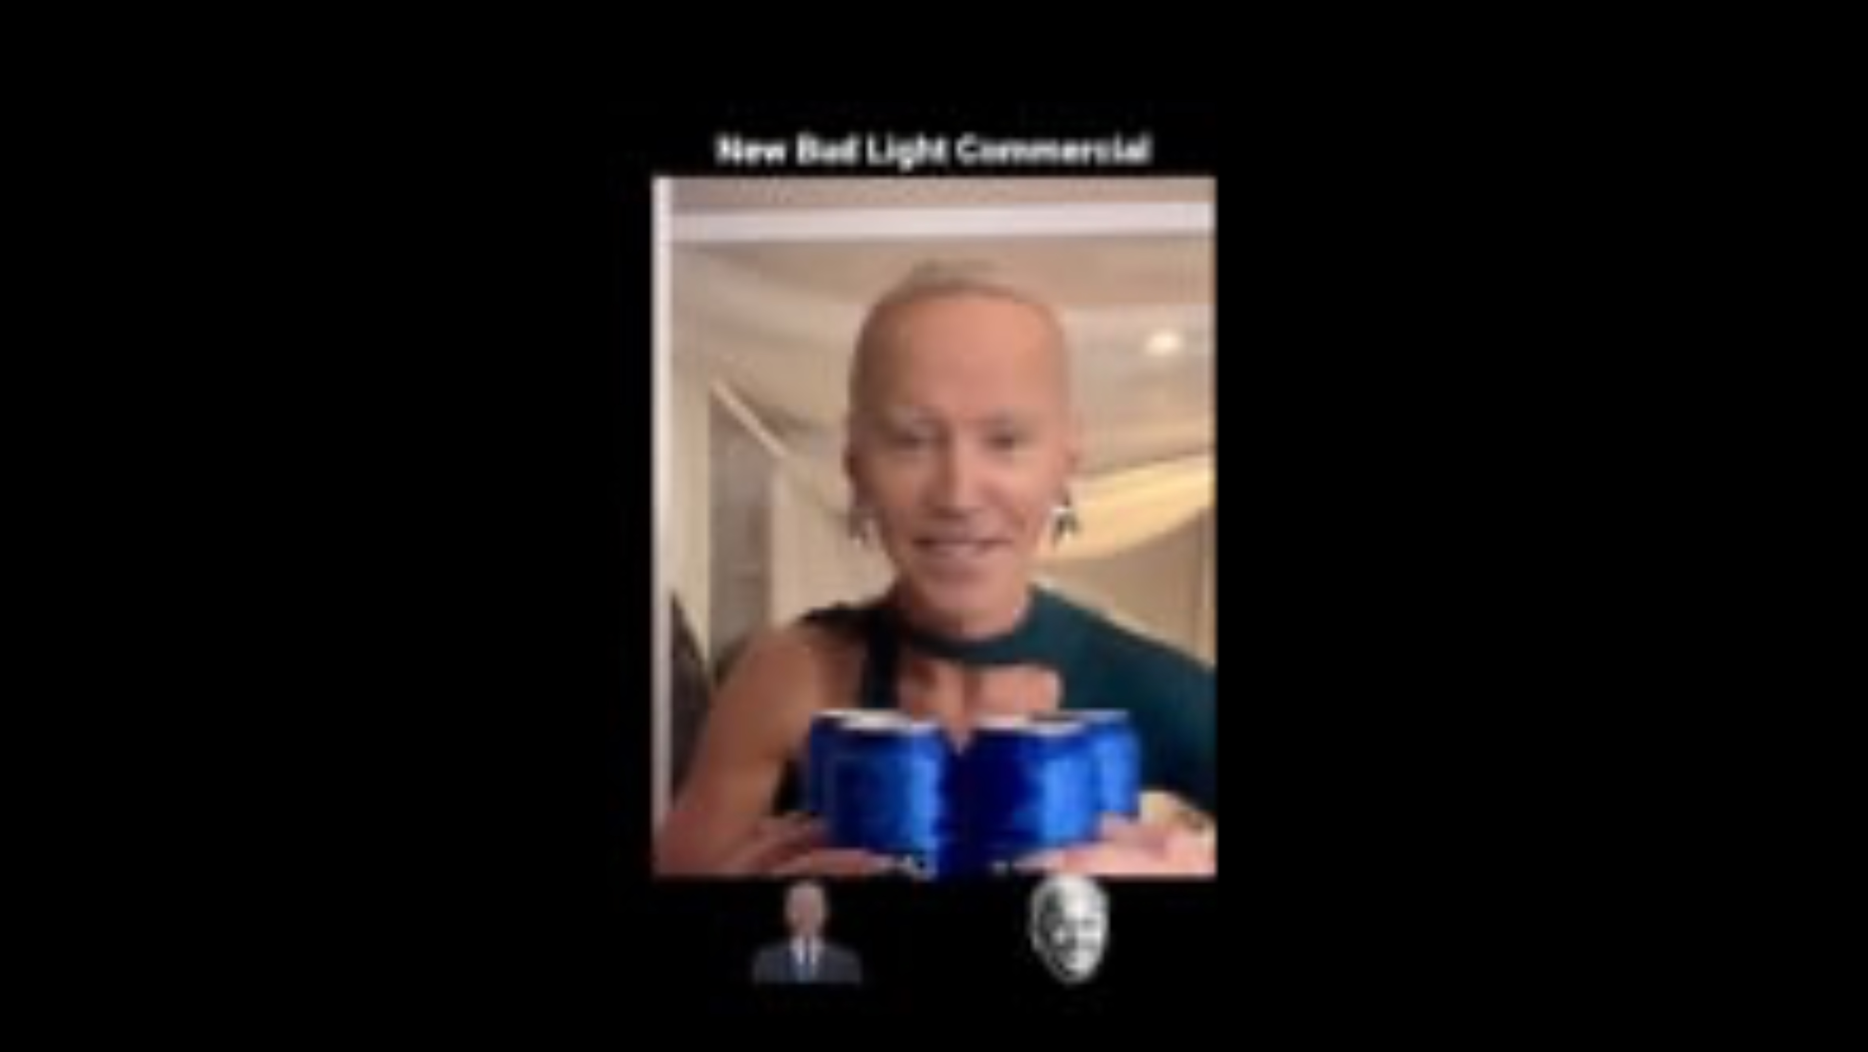
DEEPFAKE – A Video Essay

Slide 17
DEEPFAKE
The Data
The Algorithm

Slide 18
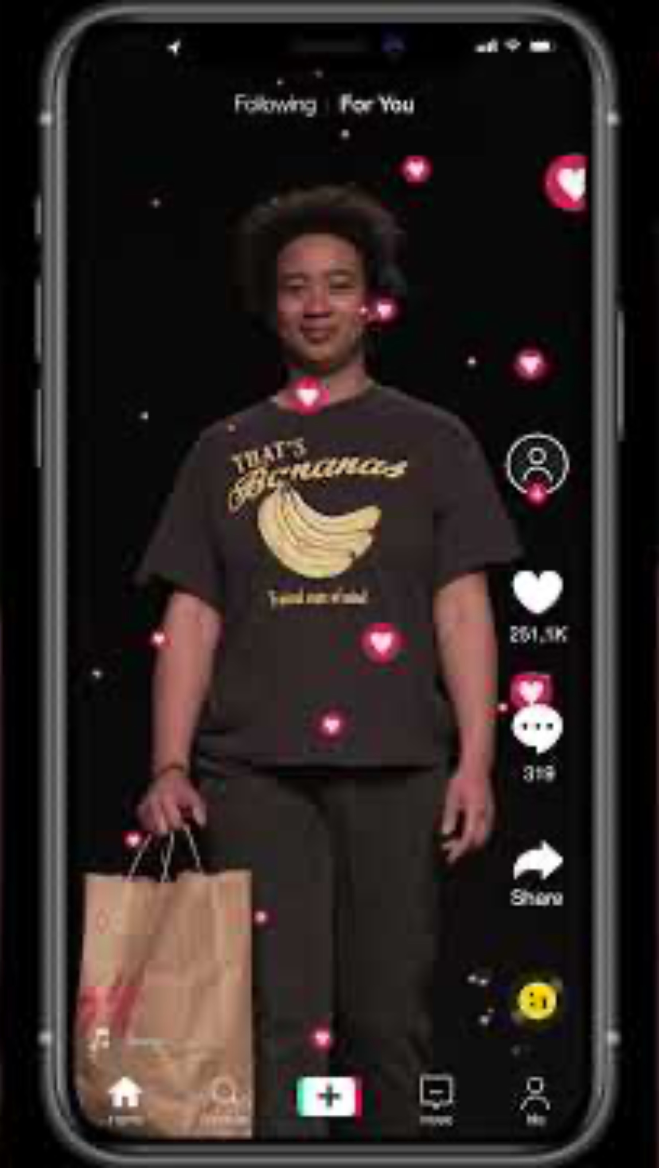
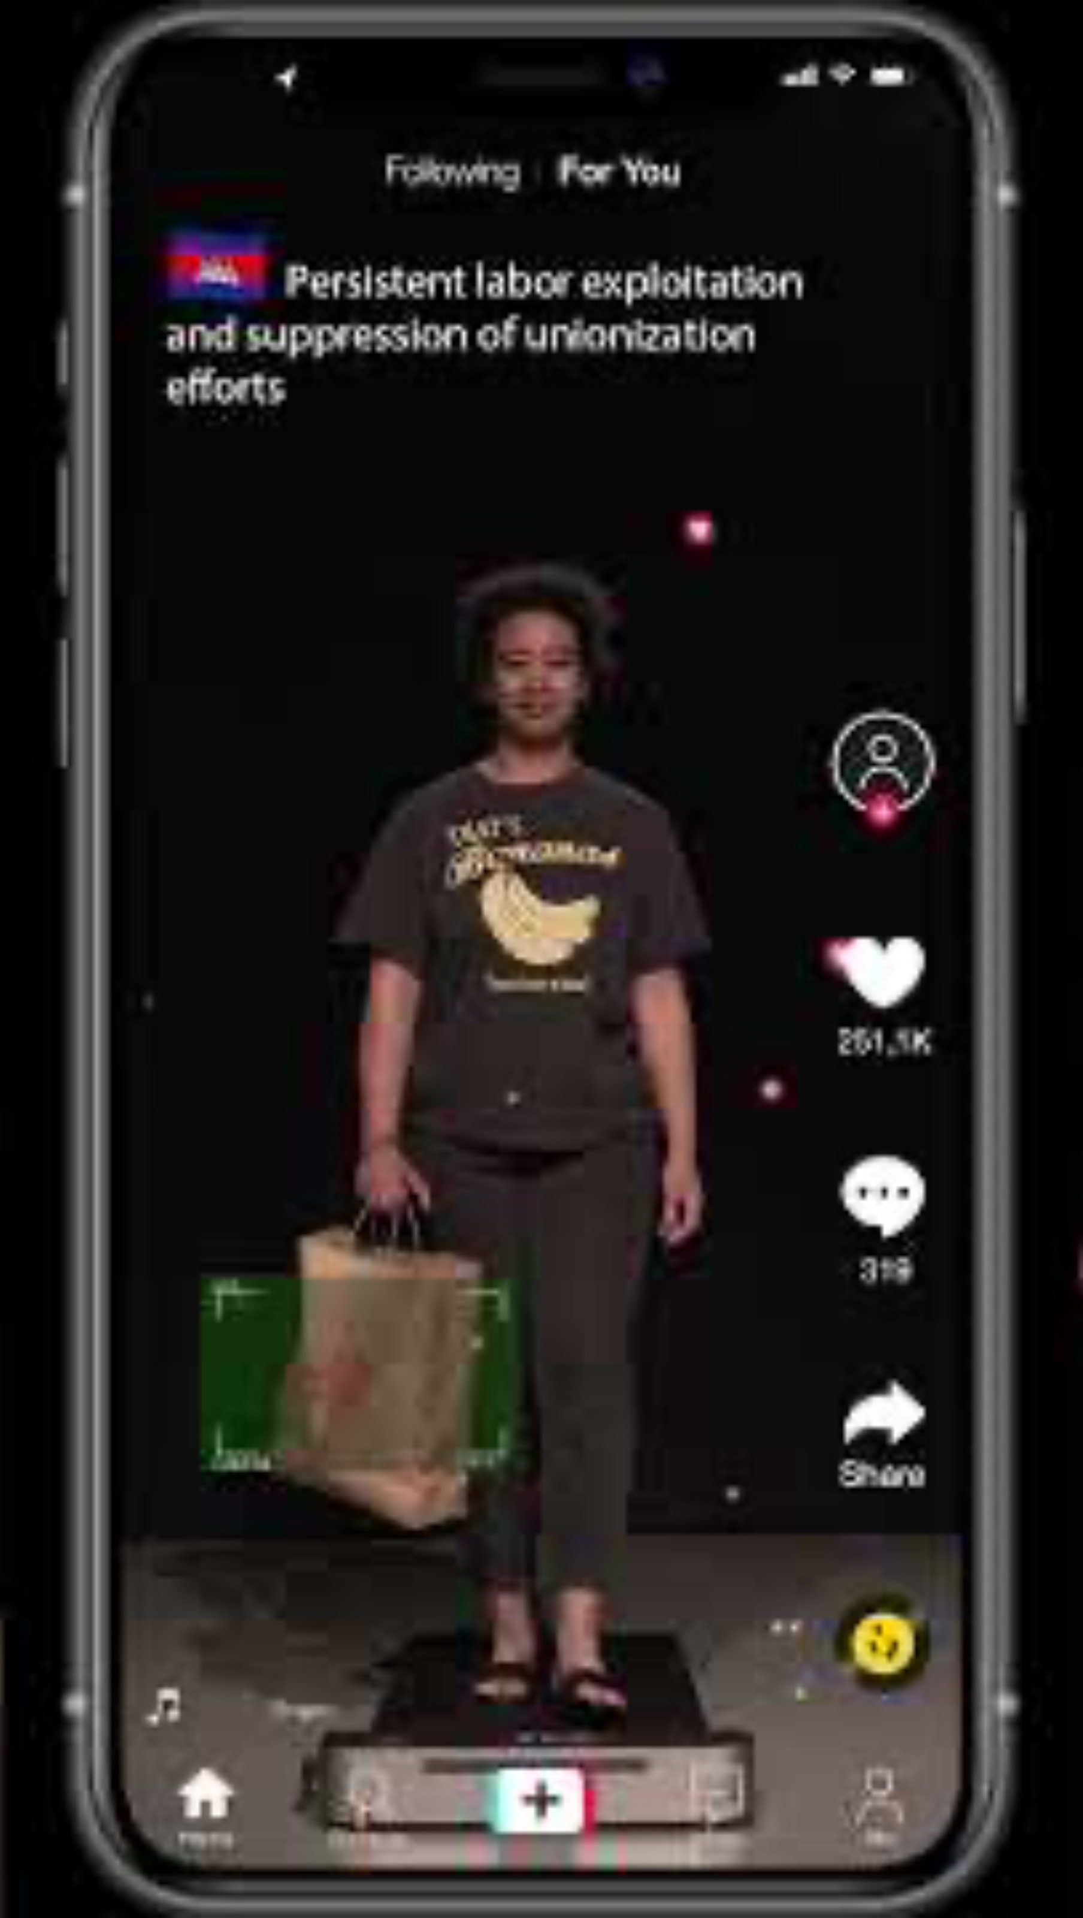
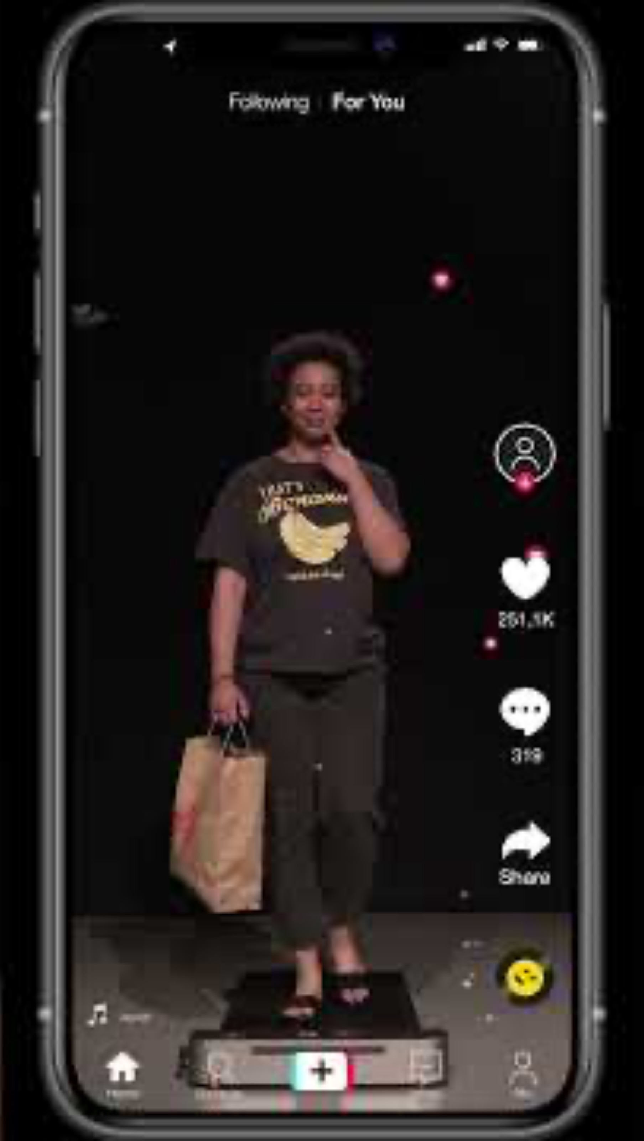
Fashion Police Drones

Slide 19
Fashion Police Drones
The Data
The Algorithm

Slide 20
To Explore Alternative Possibilities

Slide 21
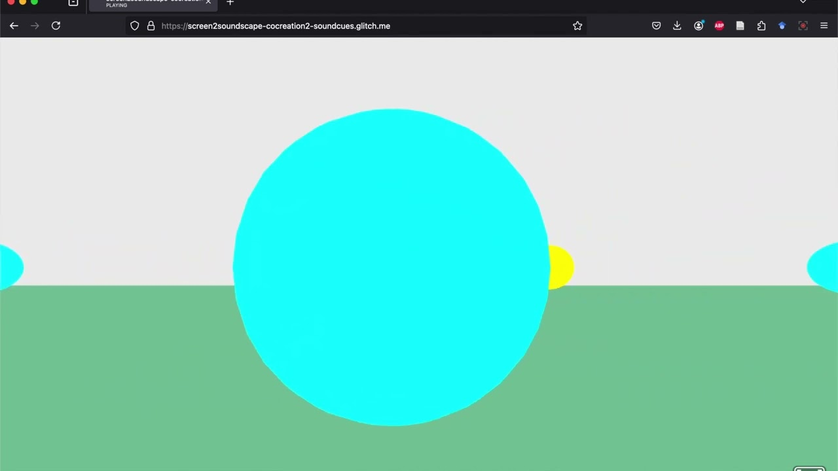
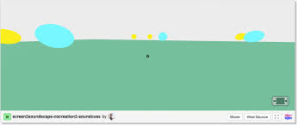
Screen to Soundscape

Slide 22
Screen To Soundscape
The Data
The Algorithm

Slide 23
Surveillance, Machine Vision & Imagination

Slide 24
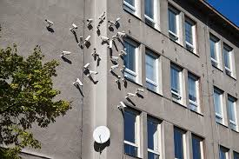
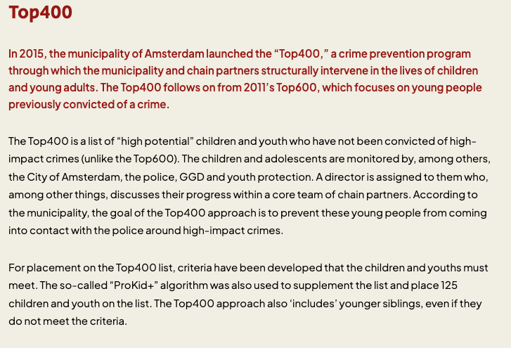
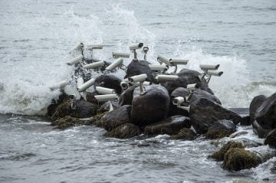
Surveillance Infrastructures as World Building: Data Collection
Czech artist Jakub Geltner
Notes:
Benjamin’s line that we’re “living inside someone else’s imagination” is very literal when you look at how machine vision is built.
Surveillance as World-Building: When Data Collection Designs the City
On the slide (bullets):
Cameras, platforms, sensors = infrastructure of imagination
What gets collected: movement, faces, “risk scores,” health & mood data
Amsterdam’s Top400: profiling youth “most likely” to commit crime
Data flows between police, schools, health services, social work
We’re not just measuring reality — we’re building a world of suspects & “at-risk” bodies
How you might talk it through:
Explain that Top400 is a local example of predictive identification: a list of children and young adults in Amsterdam profiled as high risk for future “high impact crimes,” based on police data, social services, neighborhood, family ties, etc.
Stress Benjamin’s point: these infrastructures materialize a particular imagination of the city—where some kids are treated as problems before they’ve done anything.
When engineers train a system on mugshots, border-crossing footage, or “suspicious behavior” clips, they’re not just picking convenient data—they’re choosing a worldview:
They decide whose images count as data: people in prisons, at borders, under police watch, in “high-crime” neighborhoods.
They decide what counts as a problem: loitering, trespassing, shoplifting, “illegal” border crossing.
They decide what labels exist at all: “gang member,” “threat,” “undesirable,” “approved,” “low risk.” Those labels are not neutral descriptions; they’re political fantasies about order—about who belongs, who is out of place, who must be watched. Benjamin’s “New Jim Code” is exactly this: systems that encode racism and hierarchy while wearing the costume of technical objectivity.
So a model isn’t just statistical; it’s a compressor for a particular imagination about race, danger, mobility, and citizenship.

Slide 25
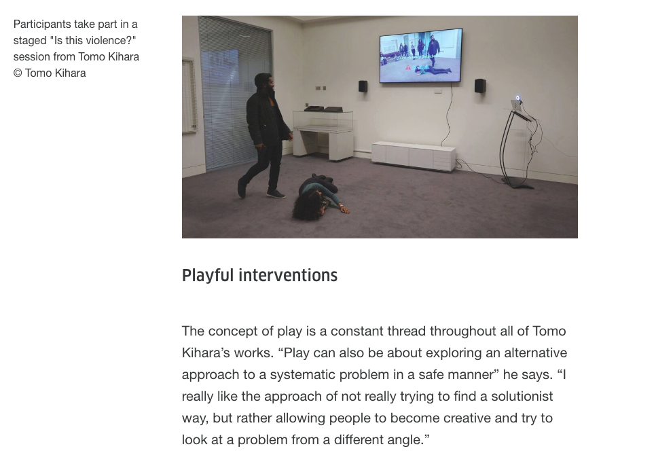
Machine Vision as Frozen Imagination: Violence
Notes:
On the slide (bullets):
Training data + labels = compressed worldview
Categories like “gang member,” “illegal migrant,” “high-risk youth”
These are political fantasies about danger, not neutral facts
Ruha Benjamin’s New Jim Code: racism updated and automated
Once encoded, systems keep replaying the same imagination of who is risky
How you might talk it through:
Link Top400 back in: the risk model is trained on prior police data and social indicators, so past over-policing of racialized, poorer neighborhoods becomes a self-fulfilling prophecy.
“Frozen imagination” = crime, risk, and deviance are no longer debated; they’re fixed into scores and lists that follow people for years.

Slide 26

Frozen Imagination is Profitable!
1.5 million Uyghurs and Turkic Muslims
European & American Predictive Policing Software
Profit generated in 3 interconnected ways:
State contracts
Advanced Software
Cheap Labour
Notes:
1.5 million Turkic Muslims (Uyghurs)
Profit generated in 3 interconnected ways:
Lucrative state contracts are given to private corrporations to build and deploy policing technologies that surveil and manage target groups
Using the vast amounts of biometric data and social media data extracted from those groups, the private companies improve their technologies and sell retail versions of them to ther states and institutions
Turns the target groups into a ready source of cheap labor – either through direct coercion or indirectly through stigma

Slide 27
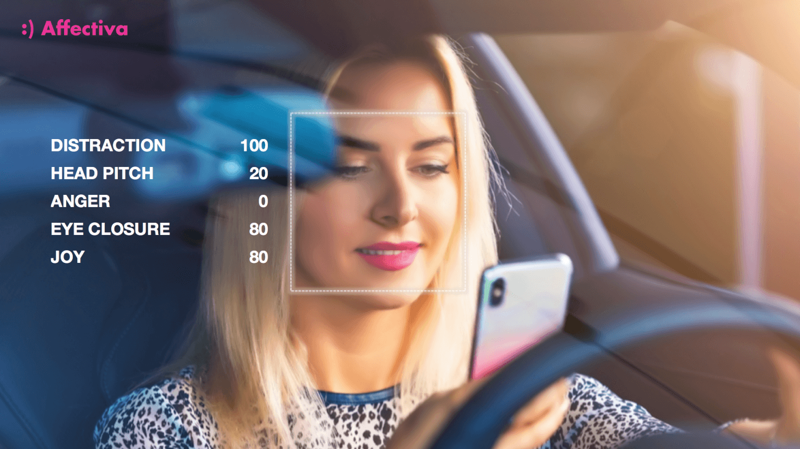
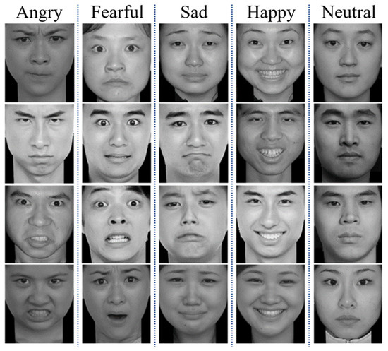
Machine Vision as Frozen Imagination: Expression
Notes:
Benjamin often says we’re “living inside someone else’s imagination.” howtocitizen.com+1 If you map that onto machine vision and surveillance:
Machine vision as frozen imagination
When you train a facial recognition system on mugshots or immigration datasets, you are literally encoding a carceral imagination: one that sees people first as risk, threat, or illegality.
The labels—“loitering,” “trespassing,” “shoplifter,” “illegal migrant”—are not neutral categories; they’re political fantasies about who belongs where.

Slide 28

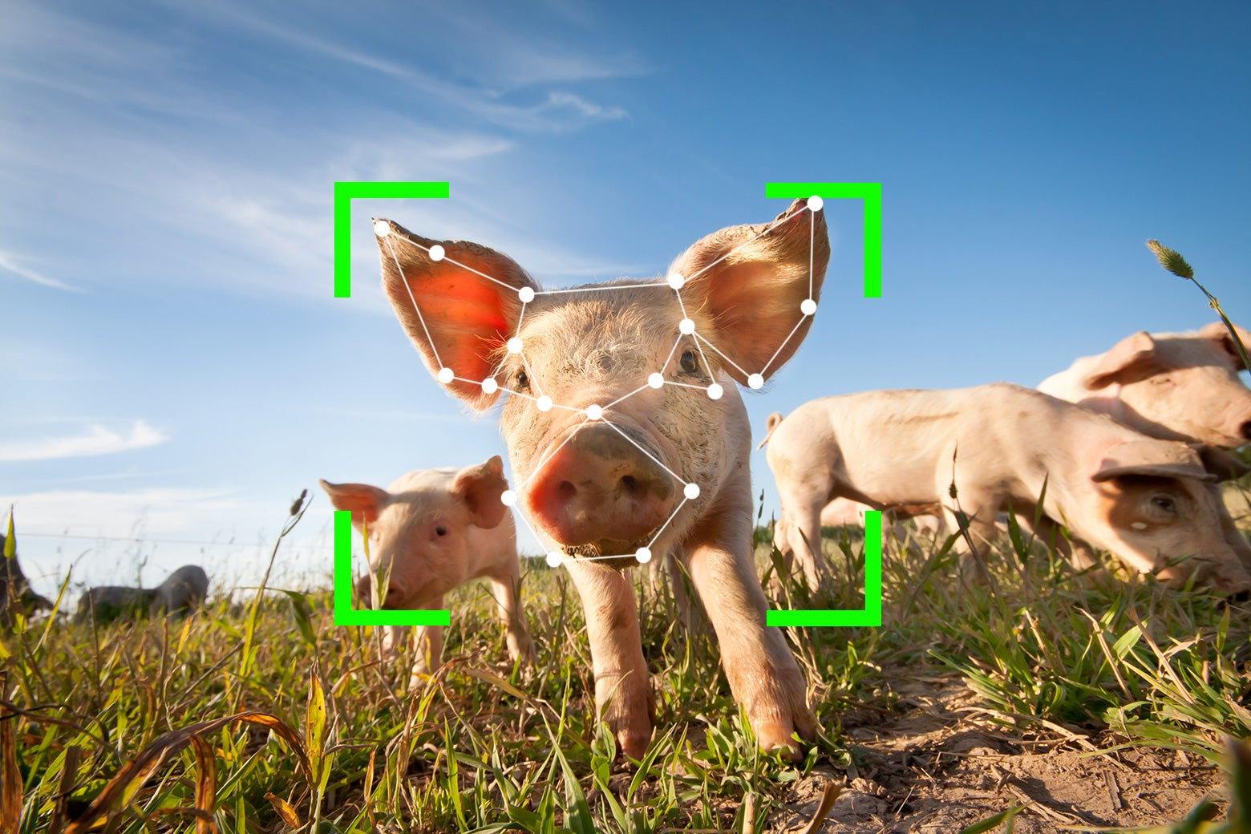
Machine Vision as Frozen Imagination: Health
Notes:
– Beauty filters, skin smoothing, “symmetry = attractiveness”. – How these models erase scars, disability, trans bodies, veils, etc

Slide 29
Imagination as abolitionist counter-tech
What would tech look like if it were built from an imagination of care rather than control?
Refusal
Redirection
Re-imaging sensing itself
Notes:
That can mean at least three moves:
Refusal Some systems shouldn’t exist at all: migrant-scoring, “dangerousness” prediction, emotion detection for job interviews, “race detection” filters, etc. Saying no is a design decision.
Redirection Use the same skills—computer vision, data infrastructure—to build community tools:
platforms to coordinate mutual aid or tenant organizing;
tools that help people understand and resist surveillance;
data co-ops where communities govern their own datasets.
Re-imagining sensing itself Art, Afrofuturism, speculative design: using cameras and sensors not to punish, but to practice other relations—solidarity, mutual visibility, playful distortion, collective memory.
Abolition here is less “turn everything off” and more “change what the tech is for.”

Slide 30
Imagination as abolitionist counter-tech
Not enough to ask, “Is the dataset biased”
One must also ask:
Who is presumed dangerous, border-cross, or fraudulent?
Who is allowed opacity, privacy and anonymity?
What non-machine vision methods of sensing and vision were ruled out before the project began?
Notes:
Imagination as an audit criterion
“Is the dataset biased?” is a small question. An imagination-aware audit asks bigger ones:
What kind of world does this system presuppose and reproduce?
Who is cast as risky, fraudulent, or out-of-place—and who is presumed legitimate?
Who is allowed opacity and anonymity, and who is subject to continuous legibility?
Did we ever seriously explore non-carceral uses of these same techniques—or did we assume the only possible use was enforcement?
Instead of only asking “Is this accurate?”, Benjamin is asking us to ask “Accurate for which imagination?” Accuracy in the wrong imagination is just sharper harm.

Slide 31
Self-Surveillance, Machine Vision & Beauty (A Case Study)

Slide 32
Training a Cosmetic AI: World Building
Criteria:
No Textured Skin
Lighter Skin
Smaller nose
Bigger Eyes
Slimmer or Wider Chin
Fuller Lips
Training Photos:
Celebrities
Pre/Post Surgeries
Notes:
That’s an imagination about what a good face is, baked into code. It’s intimately connected to:
racial hierarchies (whiter skin, less Afrocentric features);
gender norms (feminized softness, large eyes, pouty lips);
class ideals (no signs of labor, stress, or aging).
In Ruha Benjamin’s language, we’re “living inside someone else’s imagination” when we open the front-facing camera: an imagination shaped by Western beauty industries and platform metrics.

Slide 33
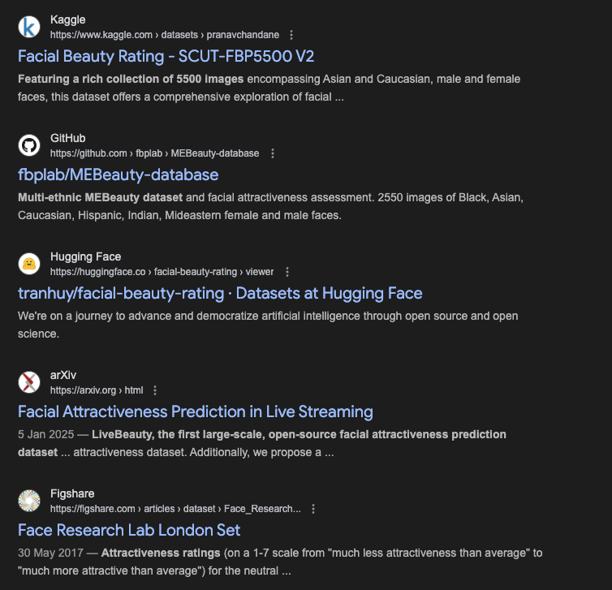
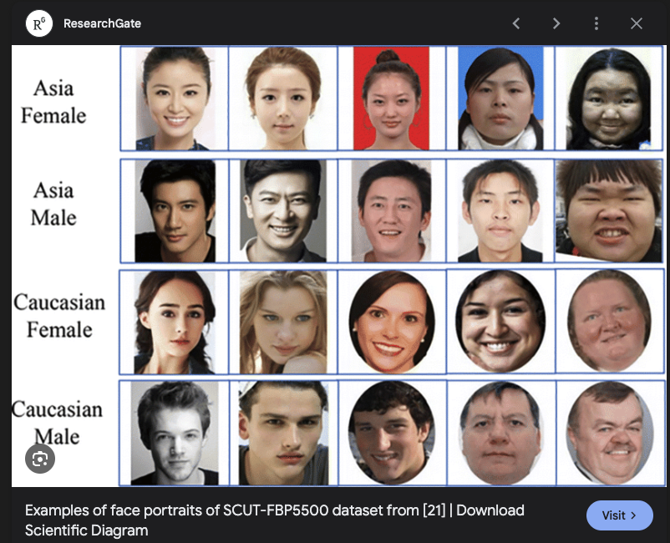
Training a Cosmetic AI: World Building
Notes:
You can read a TikTok or Instagram beauty filter exactly like a predictive-policing model:
Someone chose the training images and reference faces.
Someone decided that lighter skin, smaller nose, bigger eyes, fuller lips, no texture are “improvements.”
Someone encoded those choices as the slider labeled “beautify.”

Slide 34
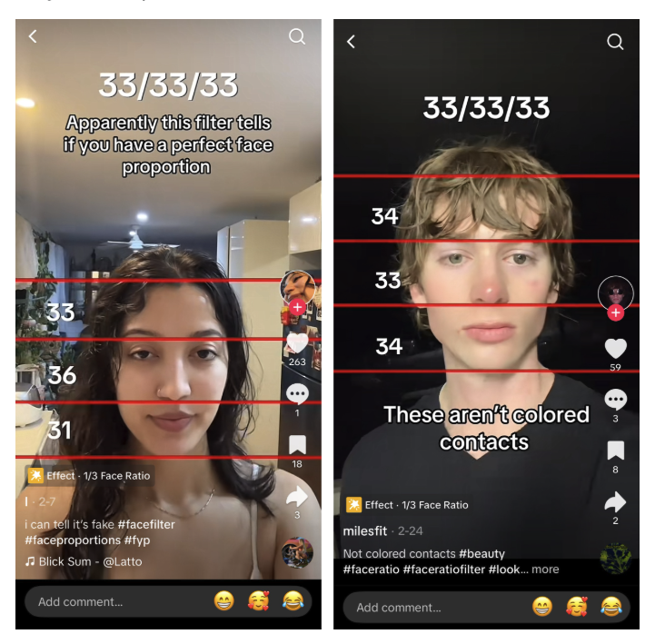
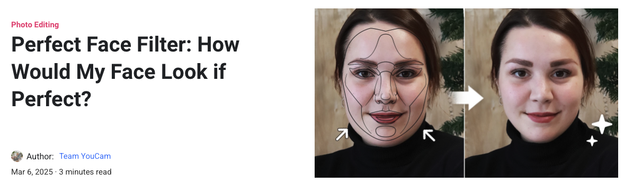
Frozen Imagination: The Algorithmic Ideal Face
Notes:
Explain “frozen imagination”: the messy, contested idea of beauty is compressed into a single, repeatable transformation.
Note how it repeats the same edits across very different faces, erasing racial, age, and gender diversity.
Connect to Benjamin: like predictive policing encodes a carceral imagination, beauty filters encode a cosmetic imagination that privileges whiteness, youth, and thinness.
Stress that calling it “fun” or “just a filter” hides how much power that frozen ideal has over self-perception.

Slide 35
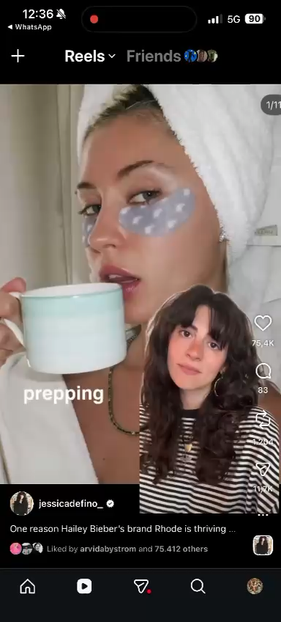
Living in the Mirror World
Notes:
On the slide (bullets):
We don’t just use filters; we learn to see ourselves through them
The filtered face becomes the reference, the “real” face feels wrong
People change offline—makeup, angles, even surgery—to match the algorithmic ideal
This is a form of self-surveillance: policing our own faces for the camera
Counter-imaginations: glitch filters, community-made filters, opting out
Speaker notes:
Describe the “mirror world”: the phone screen becomes a second mirror that quietly outranks the first.
Link to Ruha Benjamin’s line: we live inside someone else’s imagination every time that filtered face feels more acceptable than our own.
Talk about how this trains people—especially young people—to constantly monitor and correct themselves, even when no one is looking.
End with openings: filters that celebrate “undesirable” features, refuse whitening, or deliberately break the ideal; or practices of simply posting and sharing unfiltered faces.

Slide 36
When Machine Vision Fails

Slide 37
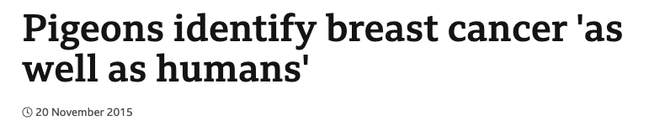
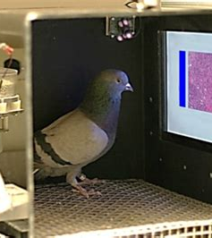
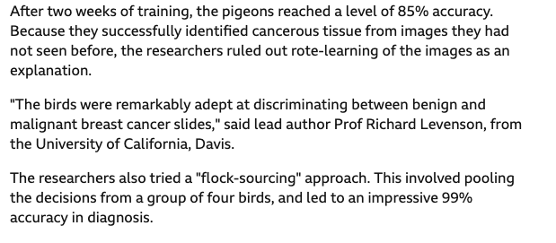
Is AI better than pigeons

Slide 38
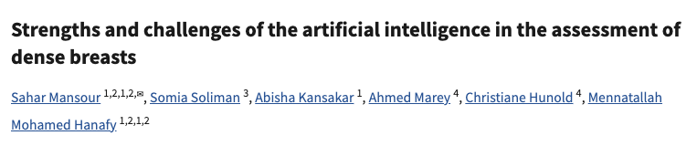
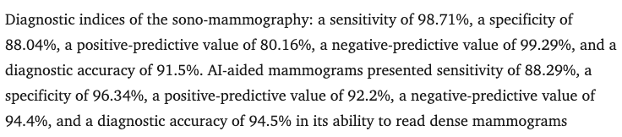
Is AI better than pigeons

Slide 39
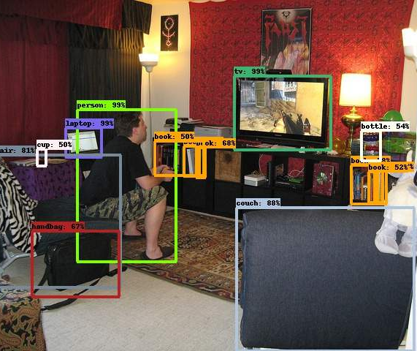
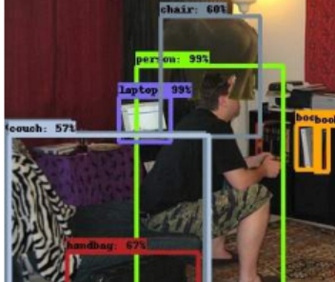
When Computer Vision Fails

Slide 40
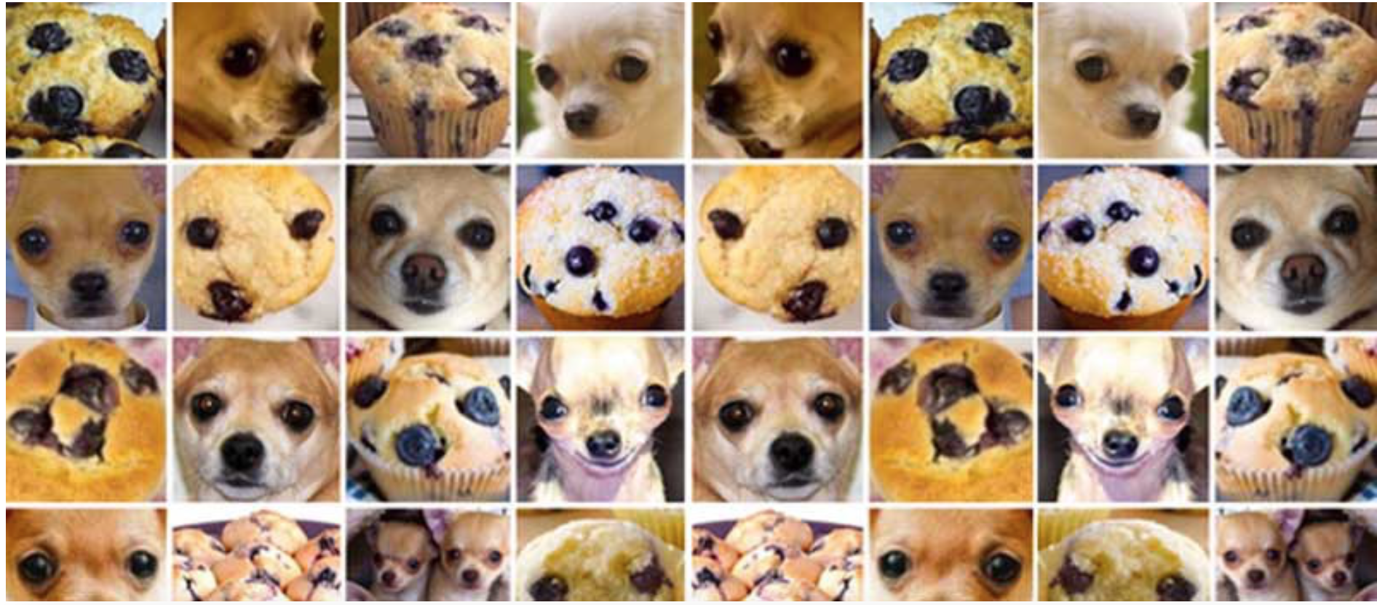
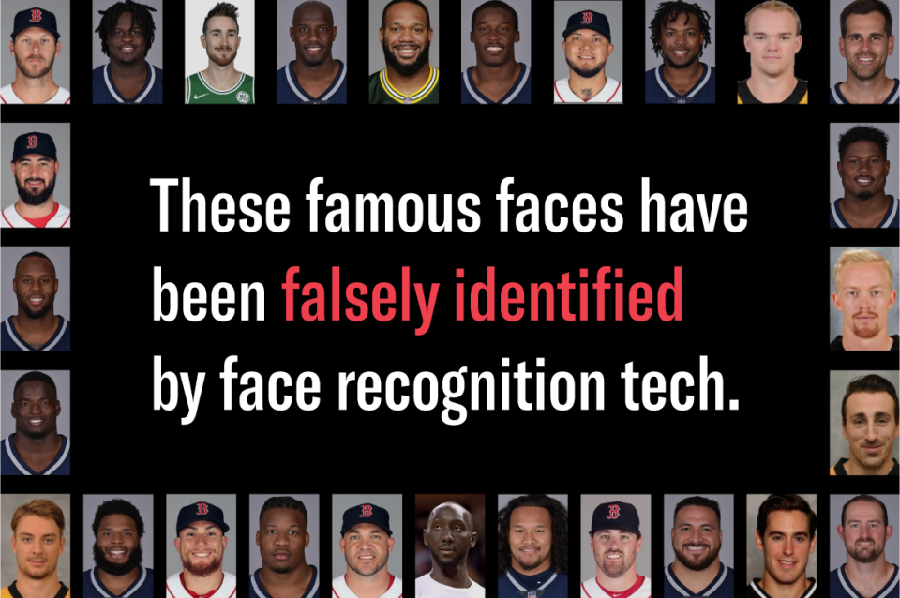
When Computer Vision Fails

Slide 41
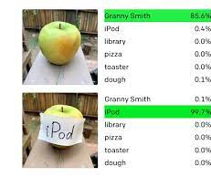
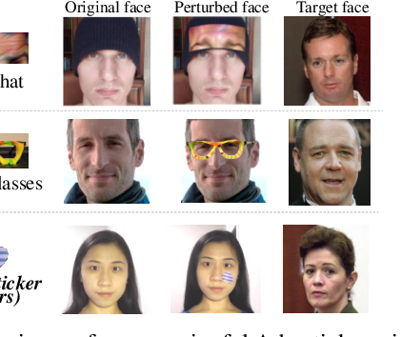
When Computer Vision Fails

Slide 42
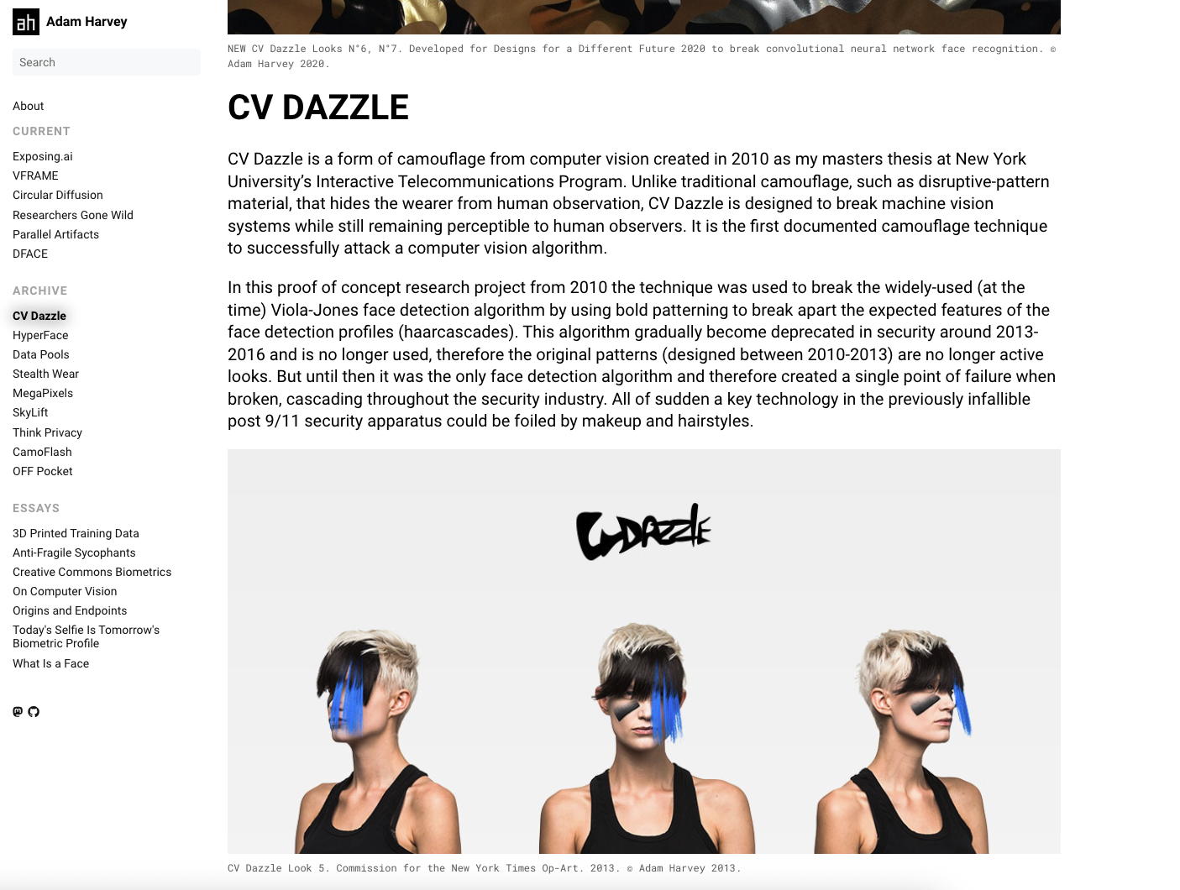
CV Dazzle

Slide 43
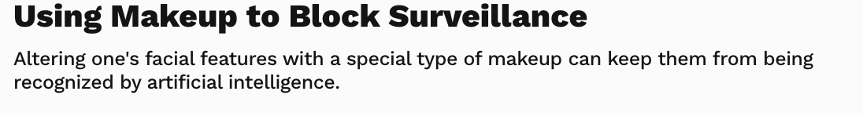
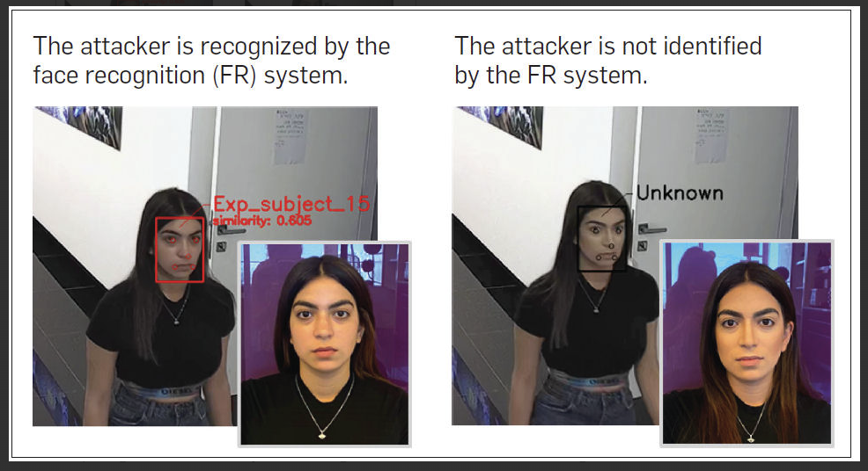
CV Dazzle

Slide 44
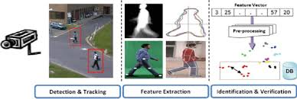
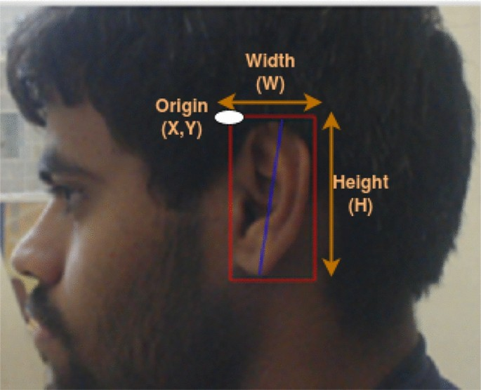
Multiple Streams of Surveillance

Slide 45
Questions?
Artificial Nouveau Studio
artificialnouveau@gmail.com

Slide 46
DIY Surveillance Workshop
http://pimeyes.com/
Build an [Fill In The Blank] Classifier

